Slide 1
Platform for Visualizing Life Cycle Assessment and Tracking of Consumer Products
Daniel Bischoff
Steffen Herrdum
Lin Xu

Slide 2
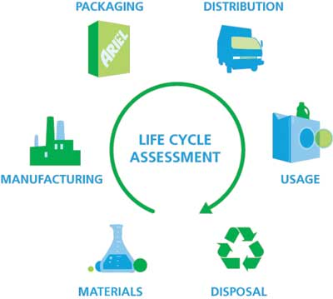
What is LCA?

Slide 3
What are we doing?

Slide 4
Technology
Platform: Html, javascript, CSS3
Libraries:
DataMap
Polymer
http://datamaps.github.io/
https://www.polymer-project.org/

Slide 5
Main Tasks
Analyse Data structure
User interface design

Slide 6
Limitations
Only constructed data
Limited productions

